Slide 1
Object Oriented Methodologies
Dr. Ranjana Vyas
Indian Institute of Information Technology, Allahabad

Slide 2

Dr. Ranjana Vyas : Brief Introduction
Has done Doctorate in Data Mining and Business Intelligence.
Worked in Research Project at Rostock University (Germany).
Research Workshop participation in Complexity School in Italy.
Post Doctoral Fellowship at Technical University of Kaiserslautern (Germany).
Experience of ~ 10 years, many research publications, guided Ph.D.Scholars.

Slide 3
OOM
OOM is all about writing programs in C++ ??
Right ??
No….
OOM is about programming in Java or C # ??
Not Exactly !!
So What OOM is all about?
Well, there is more to OOM than simply programming.
In OOM the problem-solving approach has to be different.

Slide 4
OOM
OOM is not only writing programs in Java / C++ / Visual C+, C # .
OOM is about -
Thinking in Object Oriented Manner !
Design with Object Oriented Modeling !!
  UML
Develop using Object Oriented Technology !!
  JAVA
Maintain/Reuse in Object Oriented Approach !!!

Slide 5
OOM Course Content
&
Evaluation-Grading System

Slide 6
OOM : Course Contents
  Different Programming Paradigms
    Procedure Oriented Vs. Object Oriented
  OOP Concepts
  Objects & Classes: Elements of the Object Model.
  Software trends & Use of OOM : Web Technology, Business Intelligence & Apps.
OOM Characteristics & Advantages
Developing Mini Projects using OOM
OOM Implementation :
  OOM for Writing Programs & OOM for Software Projects.
  Java & UML
    Working of a Java Program
      Compiler-Interpreter & Java Programming
    Java Functionality: JVM & Applets
    Developing Software Projects with OOM

Slide 7
Our Approach …
Concepts of OOPS
Implementations of OOPS using Java :
  JAVA
    Overview of Java Platform:
      Writing Java codes: Implementing OOPS using Java
    Tools needed: JDK , IDE: NetBeans , Eclipse…..
  UML
    Object Oriented Modeling for a S/W project
Reference Material:
OO Analysis & Design : Grady Booch
UML User Guide, Grady Booch, James Rumbaugh, Ivar Jacobson, Addison Wesley, 1999.
Java 2 : A Complete Reference

Slide 8
OOM : Grading & Evaluation Approach
Surprise Quiz !!
Conceptual Understanding through Java implementation
  Lab. Exercises: Simple problem solving Introducing Core Java.
    No Grading for First 02 weeks
      So No Copy / Paste in Assignments please !
      Concentrate on Learning the fundamentals .
    Simple individual assignments for next 04 weeks & Mini Projects / Group assignments for remaining weeks.
  OOM Design & Methodology
    Design concepts & Modeling notations
    Project management in OOM: UML diagrams
    Learning of Advanced Java Concepts through assignments
Notes:
Ranjana vyas

Slide 9
Programming Language Paradigms
  The term Paradigm describes a set of techniques, methods and standards that together represent a way of thinking for problem solving.
  Language Paradigms are divided into two parts
    Imperative
      Procedure Oriented Programming
      Object Oriented Programming
    Declarative

Slide 10
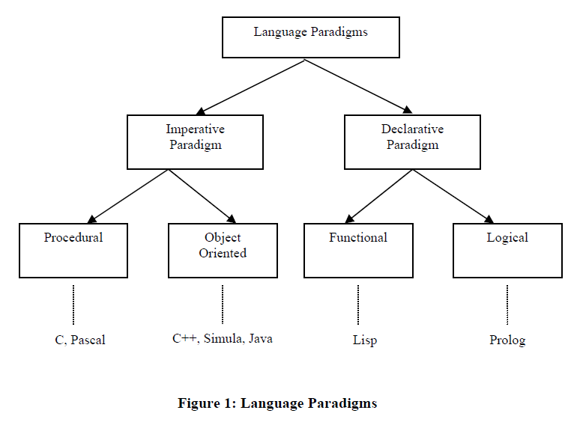
Programming Language Paradigms
Expressing command or order

Slide 11
Different Programming Paradigms
Procedural programming:
  Program is a list of instructions to the computer. Ex. C Program.
Object-oriented programming
  Program is composed of a collection : objects that communicate with each other.
OOPS with C++ / Java / C#
  Why OOPS ? Does it not use Procedures ??
  Does OOM characteristics remain same or different for C+ / Java / C# ??
  Writing a procedure to solve a specific task is a fundamental programming concept used in both procedural languages and in object-oriented programming.
Notes:
flexibility, easing changes to programs
easier to learn
simpler to develop, maintain and analysize

Slide 12
Different Programming Paradigms
Procedural programming:
  Program is a list of instructions to the computer. Ex. C Program.
Object-oriented programming
  Program is composed of a collection : objects that communicate with each other.
OOPS with C++ / Java / C#
  Why OOPS ? Does it not use Procedures ??
  Does OOM characteristics remain same or different for C+ / Java / C# ??
  Writing a procedure to solve a specific task is a fundamental programming concept used in both procedural languages and in object-oriented programming.
Notes:
flexibility, easing changes to programs
easier to learn
simpler to develop, maintain and analysize

Slide 13
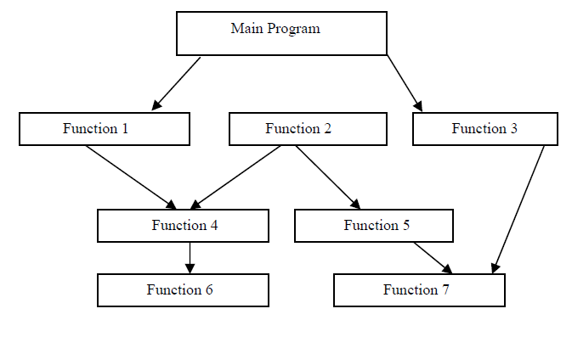
Structure of Procedural Oriented Program
A Program is a List of Instructions.
Each statement tells the Computer to do something-
  Get some Input, Do some computation task & finally give Output.
  Computational task is known as Function or Procedure

Slide 14
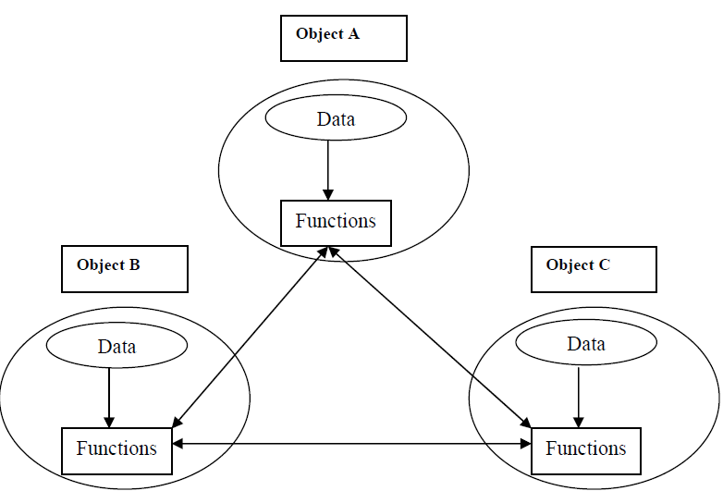
Object Oriented Programming
Object-oriented programming (OOP) is a programming paradigm
that uses "objects" and their interactions to design applications and computer programs.

Slide 15
Object
An object is a self-contained entity that consists of both data and methods (or Functions) .
Data2
Data 1
Data3
Methods

Slide 16
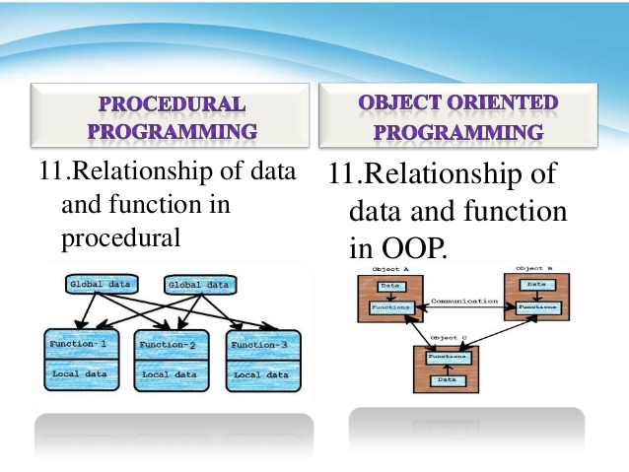

Slide 17
OOM
OOM is…..
Not only Object Oriented Programming !
But Also Object Oriented Analysis & Design !!
And OOM is Software project development using Object Oriented Technologies & Tools!!
Maintain in Object Oriented Approach !!!

Slide 18
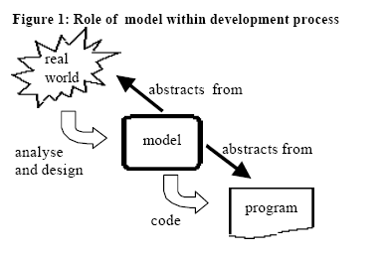
OOM
Heart of Object-Oriented Methodology is the construction of a model for good Software Design.
The model abstracts the essential details of the Problem from its usually complicated real world.
This assumes special significance in handling Medium / Large sized software projects
The OO model is then implemented in to programs using any OO Programming language.
Notes:
Ranjana vyas

Slide 19
Procedure Oriented Vs. Object Oriented
In the early days of programming, programs were designed using flowcharts and a sort of top-down design.
  With this type of design, a large problem is solved by breaking it down into smaller tasks.
  For each of the smaller tasks, a procedure is written.
Procedural Approach was fine with smaller projects….
There were lot of difficulties in Procedure Oriented Approach for `Software developments for Medium and Large Scale Software Projects and also with recent trends like Apps !! .

Slide 20
OOM
Heart of Object-Oriented Methodology is the construction of a model for good Software Design.
The model abstracts the essential details of the Problem from its usually complicated real world.
This assumes special significance in handling Medium / Large sized software projects
The OO model is then implemented in to programs using any OO Programming language.
Notes:
Ranjana vyas

Slide 21
Procedure Oriented Vs. Object Oriented
In the early days of programming, programs were designed using flowcharts and a sort of top-down design.
  With this type of design, a large problem is solved by breaking it down into smaller tasks.
  For each of the smaller tasks, a procedure is written.
Procedural Approach was fine with smaller projects….
There were lot of difficulties in Procedure Oriented Approach for `Software developments for Medium and Large Scale Software Projects and also with recent trends like Apps !! .

Slide 22
Why OOM ???
OOM & Recent Software Trends…

Slide 23

OOM & Mobile Apps..
A mobile application (or Mobile App) is software written for mobile devices that performs a specific task, such as a game, calendar, music player, etc.
While application development for mobile devices goes back at least 10 years, there has been exponential growth in mobile application development since the iPhone AppStore opened in July, 2008.
The term “App" has become popular, and in 2010 was listed as "Word of the Year" by the American Dialect Society
Mobile App ranges from Game or Music to business processes as well.

Slide 24
Mobile Apps development…
More and more organizations aim at leveraging mobile applications for their respective business……
Mobile Apps development market is young and growing extremely fast paced…….
The explosion of consumer apps can be seen in just about every industry, but here are a few of the more notable ones:
  Retail: Location-intelligent mobile commerce
  Media: Magazines & newspapers going 100% digital
  Travel: Mobile bookings, check-ins, maps, deals, etc.
  Education: Tablets and apps in classrooms
  Healthcare: Patient records, physician notes, etc.
  Finance: Apps for real-time trading, portfolio analysis
  Social: Games and social media platforms

Slide 25
Mobile Business Apps
And Mobile Business Apps are running in the B2B world as well, including spaces such as:
  Business Apps: CRM, ERP, HR systems
  Productivity Apps: Docs, spreadsheets, presentations
  Collaboration Apps: Email, IM, publishing
Still think that mobile apps are for games, music and “entertainment purposes” only?
Do you really think that mobile applications won’t be relevant to a industry, a company, software team and your career as Software Engineer, a year from now?
  Think again !!

Slide 26

OOM & Mobile Apps
The key quality requirements of Business App ;
  Driven by tough time-to-market constraints,
  Apps are in high demand for particular time
    Ex. FIFA World Cup Apps….
  Great user experience,
  As well as flexibility with respect to future extensions
Can you start coding with #include <stdio.h> and get above mentioned results….??

Slide 27
Object Orientation is highly suitable for
Software Re-use …….
&
Re-use is key to meet tough time-to-market constraints by developing Software quickly,

Slide 28
Alongwith Apps most of the existing Software developments in Web Technology, Enterprise Software etc are using OOM !!

Slide 29
OOM for OOM
( Object Oriented Modeling for
Object Oriented Methodology )
Notes:
Ranjana vyas

Slide 30
OOM
OOM is…..
Think in Object Oriented Manner !
Design-Model with Object Oriented Modeling !!
Develop using Object Oriented Technology !!
Maintain / Reuse in Object Oriented Approach !!!

Slide 31

Think in Object Oriented Manner..

Slide 32
Think in Object Oriented Manner
How to Think in OO Manner
  Identify Classes in Problem domain
Concepts of Class & Object
Problem Solving in Procedure Oriented Vs OO Manner
Java for OOPs: Why Java?
  C++, C# & Java: Platform independence
  How to write a Class in Java
  Attributes & Methods in Java

Slide 33
Think in Object Oriented Manner !
Every problem which needs to be programmed , should be first thought in terms of Objects !!
  Object-oriented programming (OOP) is a programming paradigm that uses "objects" and their interactions to design applications and computer programs.
  Understanding the concepts of Object and Class is key to success in Object Oriented Thinking of a particular problem.
  Interestingly we do not write Objects, in Object Oriented Programming but we write Class and we instantiate Objects !!

Slide 34
Why Java for OOPS ?
Because Java is purely object oriented, all of the statements in your Java programs appear inside a Java Class or inside an Interface.
  Even for a print statement, you need to write a Java Class
You do not write an object in object-oriented programming (OOP); you write Class and then instantiate the object(s).
  We will write Java code involving classes.
A class is saved in a .java file, and only one public class can appear in a .java file.
Compiled Java code is referred to as bytecode.
Bytecode appears in a .class file.

Slide 35
Platform Dependent
myprog.c
gcc
myprog.exe
C source code
machine code
OS/Hardware
Platform Independent
myprog.java
javac
myprog.class
Java source code
bytecode
JVM
OS/Hardware

Slide 36
How it works…!
Java is independent only for one reason:
  Depends on the Java Virtual Machine (JVM),
  code is compiled to bytecode, which is interpreted by the resident JVM,
  JIT (just in time) compilers attempt to increase speed.

Slide 37
Java Virtual Machine
The heart of the Java Platform is the concept of a "virtual machine" that executes Java bytecode programs.
  This bytecode is same no matter what hardware or operating system the program is running under.
There is a JIT compiler within the Java Virtual Machine, or JVM.
  The JIT compiler translates the Java bytecode into native processor instructions at run-time and caches the native code in memory during execution.
The use of bytecode as an intermediate language permits Java programs to run on any platform that has a virtual machine available.

Slide 38
JVM
The use of a JIT compiler means that Java applications, after a short delay during loading and once they have "warmed up" by being all or mostly JIT-compiled, tend to run about as fast as native programs.
Since JRE version 1.2, Sun's JVM implementation has included a just-in-time compiler instead of an interpreter.
Although Java programs are platform independent, the code of the Java Virtual Machine (JVM) that execute these programs is not; every supported operating platform has its own JVM.

Slide 39
How JAVA works…!
Compile-time Environment
Compile-time Environment
Class Loader
Bytecode
Verifier
Java Class
Libraries
Java
Source
(.java)
Java
Interpreter
Just in Time
Compiler
Java
Bytecodes
move locally
or through
network
Java
Virtual
machine
Java
Compiler
Runtime System
Java
Bytecode
(.class )
Operating System
Hardware

Slide 40
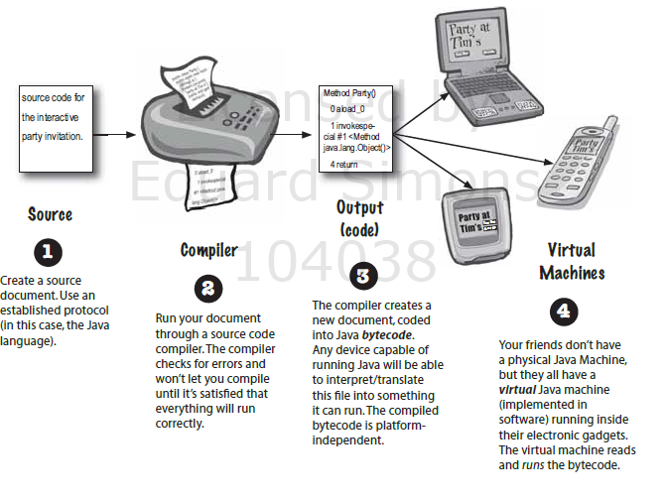

Slide 41
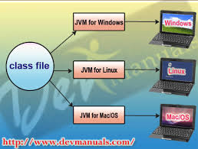

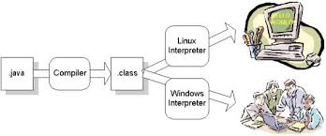


Slide 42
Java Terminologies & OOM
There are JDK, Java SDK, J2SE & JEE used very often. Is it necessary to know about them while doing OOM?
We can go on and on because there are many such terms used in Java technology but for effective OOM implementations, we needed to know atleast some of them.
JDK is an old term and means "Java Development Kit". This was replaced some time ago with J2SDK (Java 2 Software Development Kit). This one contains compilers and class library source code.
Sun now refers to the whole area of the standard edition as J2SE, to fall in line with the naming with J2EE and J2ME. When you download Suns version of the J2SE specification, it is now referred to as the Java 2 SDK.
What is J2EE & J2ME ?

Slide 43
Abbreviations
JDK = Java Development Kit - if you want to develop or just compile Java programs (*.java -> *.class -> *.jar)
JRE = Java Runtime Environment - if you want to execute a Java program.
J2SE = Java 2 Standard Edition - (JDK+JRE) - for common purposes for example on PCs
J2EE = Java 2 Enterprise Edition - AFAIK framework and methodology to produce applications in 3-layer technology (robust applications)
J2ME = Java 2 Micro Edition - (JDK+JRE) - for small devices (cellular phones, palmtops etc.)
SDK = Software Development Kit

Slide 44
Java SDK (a.k.a. JDK) —
Software Development Kit
javac
  Java compiler
java
  Java interpreter
appletviewer
  tests applets without a browser
jar
  packs classes into jar files (packages)
javadoc
  generates HTML documentation (“docs”) from source
jdb
  command-line debugger
All these are command-line tools, no GUI
3-<number>
Notes:
SDK lacks an editor, so we use non-SDK software to create the source code.
Our main tools are javac, java, and appletviewer. IDE usually has a more convenient debugger than SDK’s debugger. We recommend not using a debugger at all.

Slide 45
Java SDK (cont’d)
Available free from Sun Microsystems.
All documentation is online:
Lots of additional Java resources on the Internet:
http://java.sun.com/j2se/1.4/docs
http://www.skylit.com/javamethods/appxg.html
3-<number>
Notes:
It may be better to download Java docs together with the SDK and install them on the school server.

Slide 46
IDE for JAVA
Eclipse
NetBeans

Slide 47
Eclipse .
Eclipse is an integrated development environment (IDE) for Java.Development environment provided by Eclipse includes the Eclipse Java development tools (JDT) for Java.
You can easily combine language support and other features into any of our default packages, and the Eclipse Marketplace allows for virtually unlimited customization and extension.

Slide 48
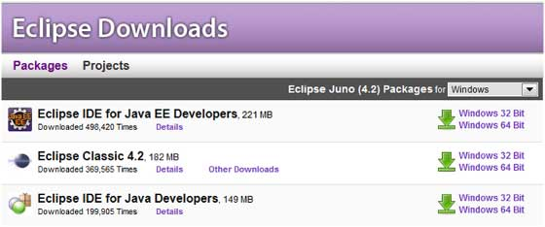
http://www.eclipse.org/downloads/

Slide 49
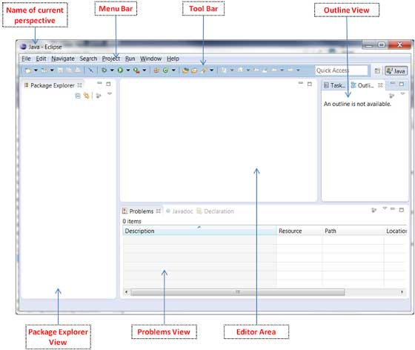

Slide 50
NETBEANS

Slide 51
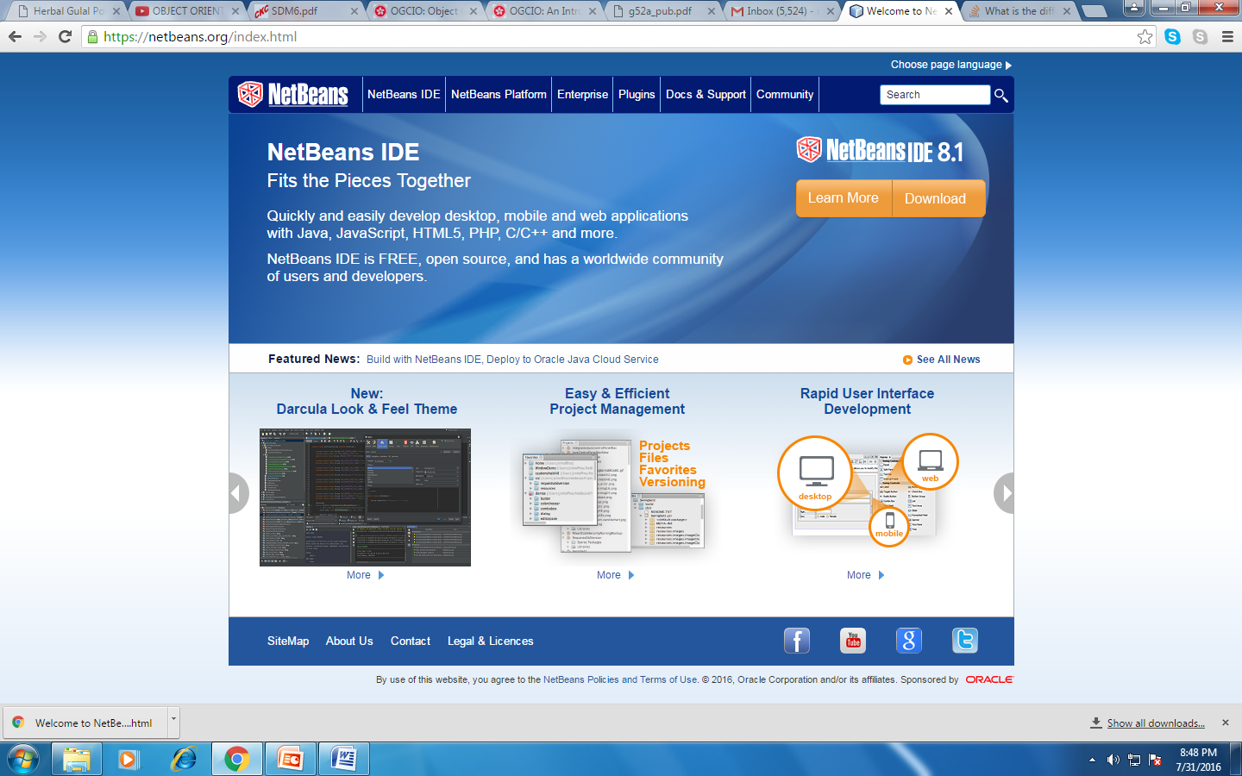

Slide 52
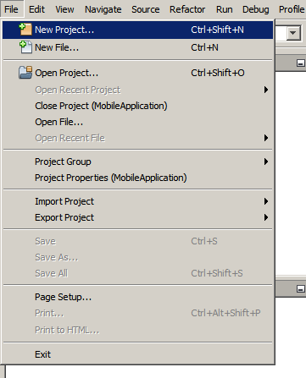
Setting Up the Project
To create an IDE project:
Start NetBeans IDE.
In the IDE, choose File > New Project, as shown in the figure below.

Slide 53
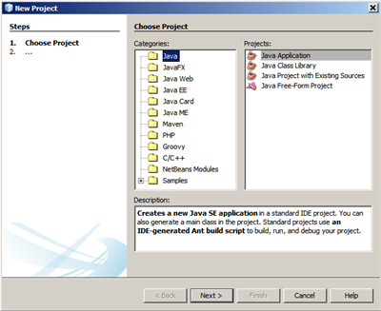
In the New Project wizard, expand the Java category and select Java Application as shown in the figure below. Then click Next.

Slide 54
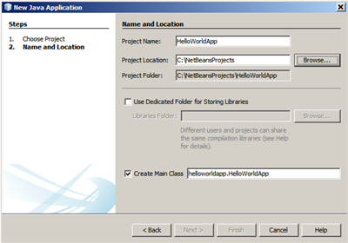
In the Name and Location page of the wizard, do the following (as shown in the figure below):
In the Project Name field, type HelloWorldApp.
Leave the Use Dedicated Folder for Storing Libraries checkbox unselected.
In the Create Main Class field, type helloworldapp.HelloWorldApp.

Slide 55
The project is created and opened in the IDE. You should see the following components:
The Projects window, which contains a tree view of the components of the project, including source files, libraries that your code depends on, and so on.
The Source Editor window with a file Called HelloWorld App open.
The Navigator window, which you can use to quickly navigate between elements within the selected class.

Slide 56
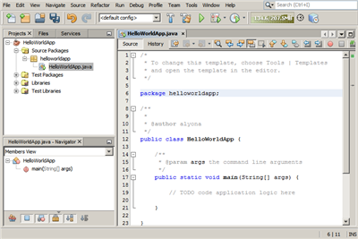

Slide 57
Example Problem
Suppose that you want to write a program to weekly pay the employees of a company.
Paying employees involves computing their pay based on hours worked or a portion of an annual salary.
In addition, you have to compute Social Security and Medicare taxes, as well as any federal income taxes to be withheld.
Each of these computations has to be repeated for each employee in the company.
Because these tasks are repeated, we can write a procedure for each one.
For example, we might write a procedure called computePay() that inputs an employee’s payment data and returns his or her pay.
You may also have procedures called computeMedicareTax(), computeSSTax(), and so forth.

Slide 58
Problem Solving:Procedures
As your employee program evolves, you will certainly find yourself adding and changing procedures so that everything works successfully.
For example, as you start writing the computePay() procedure, you might realize that there are two different types of employees (at least in terms of how they get paid):
  Hourly employees and Salaried employees.
In this situation, you might decide to write two computePay() procedures,
  one for Hourly employees and a different one for Salaried employees.
Writing a procedure to solve a specific task is a fundamental programming concept used in both procedural languages and in object-oriented programming.
But Problem Solving Approach is different……

Slide 59
Programming in OO manner
Let’s take another look at the example in which a program is to be written to pay employees of a company on a weekly basis.
  Instead of approaching this problem from Procedure Oriented (the point of view of all the little tasks that need to be performed), such as computing an employee’s pay and taxes,
  We begin by determining the Objects in the problem domain.
An object is any person, thing, or entity that appears in the problem domain.
We can think of procedural programming as writing a procedure for the verbs in the problem domain, such as paying an employee or computing taxes.
You can think of object-oriented programming as writing a class for each of the nouns in the problem domain.

Slide 60
Problem Solving in Object Oriented
As your problem evolves, you have to certainly identify objects so that OOPS works successfully.
  After you have determined the objects in the problem, you write a class to describe the attributes and behaviors of each object.
The attributes of an object will be what the object “has” such as a name, address, and so on.
Each of these attributes will be represented by a field in the Employee class.
The behaviors of an object are what the object “does” (or, more specifically, what we want the object to do).
These desired behaviors become methods in the Employee class.
Writing a Method inside a Class , to solve a specific task is a fundamental in object-oriented programming.

Slide 61
OOPS….
In our example, we want to pay employees, so the employees are objects.
The employees work for a company, so the company is another object. After further analysis, you might decide that the payroll department is an object.
After you start writing the program, other objects will be discovered that were not apparent in the initial design.
After you have determined the objects in the problem, you write a class to describe the attributes (State) and behaviors (Methods) of each object ( Employees, Company, Payroll deptt.).
For example, we will need an Employee class that contains the attributes and behaviors of an employee.
The attributes of an Employee object will be what the employee “has,” such as a name, address, employee number, Social Security number, and so on.
Each of these attributes will be represented by a field in the Employee class.

Slide 62
OOPS…..
A Class will have State and Behavior & will be for objects also
The behaviors of an Employee object are what the employee object “does”.
  Employees do many things, but for our purposes, we want to be able to compute their pay and mail them a paycheck once a week.
These desired behaviors become methods in the Employee class.
For each employee in the company, we would instantiate an Employee object.
If we have 50 employees, we need 50 Employee objects in memory, this would create 50 names, addresses, salaries, so on.

Slide 63
Writing a Java Class
A class in Java is declared using the class keyword.
A source code file in Java can contain exactly one public class, and the name of the file must match the name of the public class with a .java extension.
  For Ex. An Employee Class will be public class and code will be stored as Employee.java
The name of the source code file must match the name of the public class.
If there are no public classes in the source code file, the name of the file is arbitrary.

Slide 64
JAVA Class
The fields and methods of a class appear within the curly brackets of the class declaration.
The following code shows a simple class with no fields or
methods declared yet.
public class Employee
{
/ We have to give attributes (fields) and behaviors (methods) here !!
}

Slide 65
Adding Field (State) to a Class
The following Employee class has five fields: name, address, number, SSN and salary.
When an Employee object is instantiated in memory, memory will be allocated for each of these five fields.
public class Employee
{
public String name; //First and last name
public String address; //Mailing address
public int number; //Employee number
public int SSN; //Social Security number
public double salary; //Employee’s salary
}

Slide 66
Following class demonstrates methods by adding 02 methods to the Employee class.
public class Employee
{
public String name;
public String address;
public int number;
public int SSN;
public double salary;
public void mailCheck()
{
System.out.println(“Mailing check to “ + name
+ “\n” + address);
}
public double computePay()
{
return salary/52;
}
}

Slide 67
Class in Java
Notice about this Employee class the following:
The name of the class is Employee.
The class has five public fields.
The class has two public methods.

Slide 68
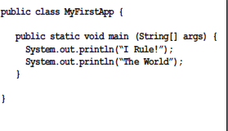

Slide 69
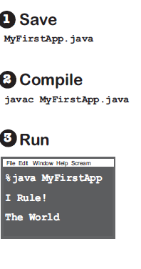

Slide 70
Methods
(Procedures) in
OOPS
& in
Procedure Oriented

Slide 71
OOPS and Procedure Oriented: Methods
While differentiating between Procedure Oriented programming and OOPs, it is highlighted that Procedure Oriented Programming uses Procedures (Methods) while OOPS uses Objects.
  But OOPS also uses Procedures (methods) because
    Writing Procedures to execute a particular task is fundamental to all the programming paradigms.
  But the difference lies in how the Methods are treated in OOPS & how its treated in Procedure Oriented.
  In OOPS, the Methods are inside a Object and is associated to it.

Slide 72
Methods in Java
  Methods in Java can appear only within a class because Java is a strictly OO programming language.
In many languages, methods appear at a global level and can be invoked at any time.
In Java, methods (not declared as static) can only be invoked on instances of the class.
  If you do want to write a global-type method that can be invoked by anyone at any time without requiring an instance of a class, you write a static method
A static method is essentially equivalent to the concept of a global method

Slide 73
Methods in Procedure Oriented Programming
Suppose that you want to write a program to weekly pay the employees of a company.
As Paying employees involves computing their pay based on hours worked or a portion of an annual salary.
Each of these computations has to be repeated for each employee in the company.
  Because these tasks are repeated, we can write a procedure for each one.
For example, we might write a procedure called computePay() that inputs an employee’s payment data and returns his or her pay.
  You may write a program with procedures called computePay() & computeSSTax(), and so forth and repeat this procedure for 50 Employees.

Slide 74
Methods in
OOPS are inside the Class and Objects are instantiated for each ( Ex.50 ) Employees

Slide 75
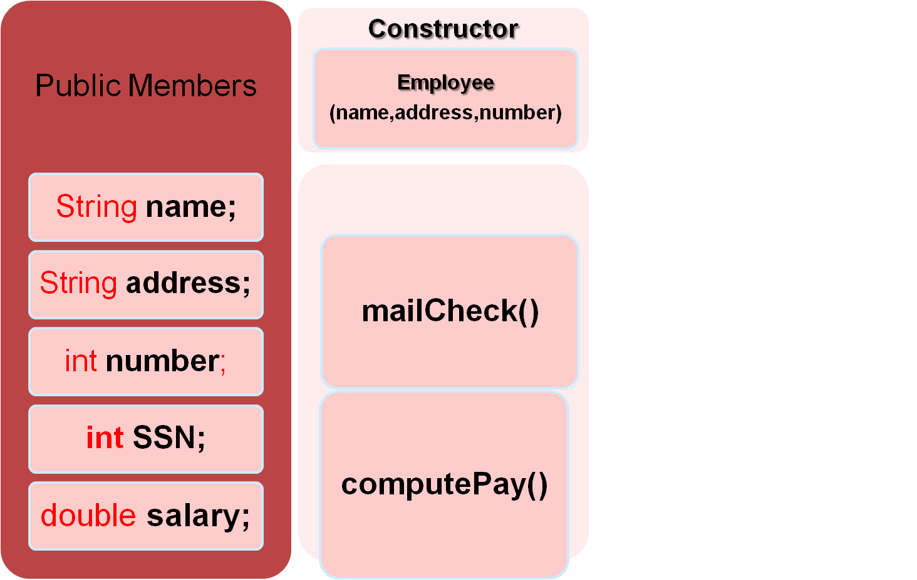
The Employee Class
Methods

Slide 76
Methods to a Class
public class Employee
{
public String name;
public String address;
public int number;
public int SSN;
public double salary;
public void mailCheck()
{
System.out.println(“Mailing check to “
+ name + “\n” + address);
}
public double computePay()
{
return salary/52;
}
}
Behaviors of an object become methods in the corresponding class. A method within a class typically consists of the Method Signature.
Definition of the method:
In Java, the definition (often referred to as the body) of a method must appear within the curly brackets that follow the method declaration.

Slide 77
Methods in Employee Class
Keep in mind that this Employee class demonstrates how to add a method to a class, that’s why the method implementations are kept simple.
  For example, the mailCheck() method simply prints out the name and address of the employee receiving the check.
  The computePay() method simply divides the employee’s salary by 52, which assumes that the salary is an annual amount.

Slide 78
The behaviors of an object are represented as methods in a class.
It is required to know the details of methods in Java, including
(i) the signature of a method,
(ii) invoking a method, and
(iii) how data is passed back and forth between method calls.
Methods in Object Oriented Approach

Slide 79
What is Method
A method is a set of code which is referred to by name and can be called (invoked) at any point in a program simply by utilizing the method's name.
  Think of a method as a subprogram that has a name, acts on data and often returns a value.
  When the name of Method is encountered in a program, the execution of the program branches to the body of that method.
When the method is finished, execution returns to the area of the program code from which it was called, and the program continues on to the next line of code.

Slide 80
Running the Java program
The Employee class needs to appear in a file named Employee.java, and the compiled bytecode will appear in a file named Employee.class.
C:\javac Employee.java
C:\java Employee
( compilation creates Employee.class )
(Execution on the local JVM)

Slide 81
Object Instantiation in Java
Class & objects

Slide 82
OOPS vs. Procedure Oriented
We can think of procedural programming as writing a procedure for the verbs in the problem domain, such as paying an employee or computing taxes.
  You can think of object-oriented programming as writing a class for each of the nouns in the problem domain.
Granted, this may be oversimplifying OOP, but this conceptually explain this important difference between OOP and procedural programming.
OOP takes an entirely different approach to developing computer applications. Instead of designing a program around the tasks that are to be solved,
  A program is designed around the objects in the problem domain.

Slide 83
What Is an Object?
Objects are key to understanding object-oriented techno.
Two important object-oriented terms: object and class.
A class is a description of an object, and an object is an instance of a class.
Examples of real-world objects:
  your Dog, Bicycle, Desk, your Television set.
Real-world objects share two characteristics: They all have
  state and behavior.
  Dogs have state (name, color, breed, hungry) and behavior (barking, fetching, wagging tail).
  Software objects also have a state and behavior.
  A software object's state is stored in fields and behavior is shown via methods.

Slide 84
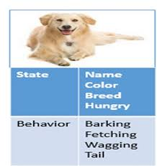

Slide 85
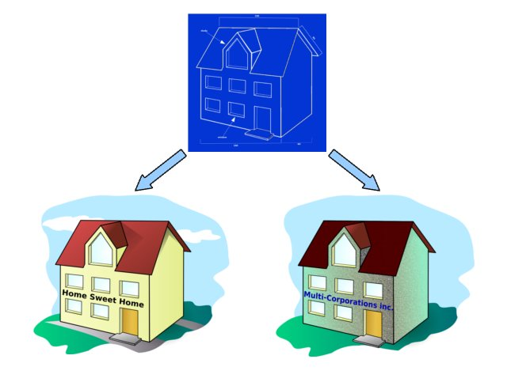
Objects & Classes
Favorite analogy when explaining classes and objects is to
  Compare blueprints of house to a class.
A blueprint of a house tells you what the house will look like when it is built,
  but it is clearly not a house—just a description of house.
When a contractor follows the blueprints and actually builds
  an instance of a house that house is an object.

Slide 86
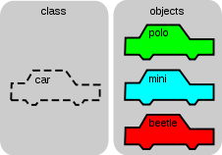
Class & Objects
How many houses can you build from a set of blueprints?
--→As many as you want.
How many instances of a class (that is, objects) can you create?
→As many as you want.
How is memory management done..? Does Class occupy memory or after creation ONLY Objects occupy memory??

Slide 87
Some more Example of CLASS & OBJECT
If Car is a class than Maruti, Audi and BMW are objects.
If Television is class than Sony Bravia, Samsung Smart TV are its object.
If Smartphone is a class then iPhone, Samsung Galaxy and Nokia Lumia are their object.
In an object oriented application, generally nouns are represented using class.
for example in finance domain Order, Trade, Instruments are classes.
In E-commerce domain Payment, Order, Products are some example of classes.

Slide 88
Object
An object is a self-contained entity that consists of both data and methods .
  Objects hide their functions (methods) and data (instance) variables)
Data2
Data 1
Data3
Methods

Slide 89
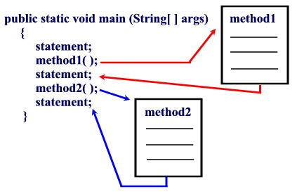
A method in Java has Method Signature.
We can determine everything for invoking about a method by looking at the method’s signature.
The signature includes information such as the
Method name,
The parameter list, and
the data type of any return value.
For example, the signature of main() is as follows:
public static void main(String [] args)

Slide 90
Employee class: Java
public class Employee
{
public String name;
public String address;
public int number;
public int SSN;
public double salary;
public void mailCheck()
{
System.out.println(“Mailing check to “ + name
+ “\n” + address);
}
public double computePay()
{
return salary/52;
}
}

Slide 91
Instantiating an Object
In Java, the new keyword is used to instantiate an object.
  The new operator creates the object in memory and returns a reference to the newly created object.
This object will remain in memory as long as your program retains a reference to the object.
The following statements declare an Employee reference and use the new keyword to assign the reference to a new Employee object.
Employee e;
e = new Employee();
The reference e is pointing to the Employee object in memory.
The new operator allocates memory for the object and then “zeroes” the memory so that none of the object’s fields will contain garbage.
Instead, all fields will have an initial value of zero.

Slide 92
Instantiating the Object
When students are first taught about instantiating objects
It is preferable to declare a reference first and then use the new keyword in a second statement to assign the reference to a new object.
This emphasizes the important fact that two entities are being created in memory: the reference and the object.
In the preceding statements, e is declared as a reference to an Employee, meaning that e can refer to any Employee object.
In the second statement, e is then assigned to a new Employee object.

Slide 93
Understanding References
A reference is (typically) a 32-bit integer value that contains the memory address of the object it refers to.
I use the term “typically” because the size of a reference is not strictly defined in the Java Language Specification.
In the future, references will likely be 64-bit integers or larger.
Similarly, they can be smaller than 32 bits when used with operating systems for small electronic devices.
Because references are essentially integers, you may wonder why they need to be declared as a particular data type.
This is because data types are strictly enforced in Java. A reference must be of a particular class data type

Slide 94
A class is like the blueprint for a house. Using this blueprint, you can build as many houses as you like.
Each house you build (or instantiate) is an object, also known as an instance.
  Each house also has an address, of course.
  If you want to tell someone where the house is, you give them a card with the address written on it. That card is the object's reference.

Slide 95
Objects and References
Once a class is defined, you can declare variables (object reference) of that type
Ship s1, s2;
Point start;
Color blue;
Object references are initially null ( The null value is a distinct type in Java and is not equal to zero)
In Java, the new keyword is used to instantiate an object. The new operator creates the object in memory and returns a reference to the newly created object.
This object will remain in memory as long as your program retains a reference to the object.
The new operator is required to explicitly create the object that is referenced
ClassName variableName = new ClassName();

Slide 96
References
For example, in the following statements, two Employee references and one String reference are allocated in memory.
Employee e1, e2;
String s;
Each of these three references consumes the same amount of memory and is essentially an integer data type.
However, the references e1 and e2 can refer only to Employee objects.
The reference s can refer only to a String object.

Slide 97
References
To illustrate this point, the following statements attempt to break this rule and are not valid;
s = new Employee(); //Does not compile
e1 = “Rich”; //Does not compile
You might think that using the cast operator could create a work-around to this situation:
e1 = new Employee(); //Valid
s = e1; //Does not compile
s = (Employee) e1; //Still doesn’t compile

Slide 98
References
However, the compiler knows that String objects and Employee objects are not compatible and will generate compiler errors in the statements above.
(Other languages such as C++ have similar data type concerns, but they are often not as strictly enforced as they are in Java.).
We could have declared the reference e and instantiated the Employee object in a single statement:
Employee e = new Employee();
This statement creates two separate elements in memory: the reference e and the Employee object.
The reference e is not an object.
The object itself does not have a variable name, and the only way you can access and use the object is to use a reference to the object.

Slide 99
Memory Management & Garbage Collection
As we can recall that in our last Ex. For each employee in the company, we would instantiate an Employee object.
If we have 50 employees, we need 50 Employee objects in memory, this would create 50 names, addresses, salaries, so on. And for more employees more objects will be created
Each employee would be distinguished by a reference, so we would need 50 references as well.
And if there are 50,000 employees then our program needs 50,000 references…!!
We have seen that how the new keyword is used to instantiate objects.
However, we have not discussed how to delete an object after you are finished with it so the memory that the object is consuming can be freed.

Slide 100
Garbage Collection
In other OOP languages such as C++, memory has to be explicitly freed by the programmer.
In fact, C++ has a delete keyword that needs to be used to free the memory of an object.
If you forget to delete an object in C++ and you lose any references to it, the memory can never be freed and you have created what is referred to as a memory leak, which can wreak havoc on your programs, especially programs that use large amounts of memory or run for long periods.
In Java, there is no keyword or operator that you can use to remove an object from memory. Java was designed to avoid the problems of memory leaks that arise in other languages.
A JVM has a low-level thread known as the garbage collector that is constantly running in the background, looking for objects in your Java program that are no longer being used and freeing their memory

Slide 101
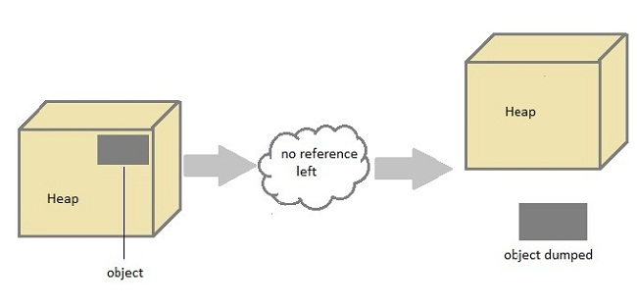
n Java destruction of object from memory is done automatically by the JVM. When there is no reference to an object, then that object is assumed to be no longer needed and the memory occupied by the object are released. This technique is called Garbage Collection. This is accomplished by the JVM.
Unlike C++ there is no explicit need to destroy object.

Slide 102
Can the Garbage Collection be forced explicitly ?
No, the Garbage Collection can not be forced explicitly. We may request JVM for garbage collection by calling System.gc() method. But This does not guarantee that JVM will perform the garbage collection.
Advantages of Garbage Collection
Programmer doesn't need to worry about dereferencing an object.
It is done automatically by JVM.
Increases memory efficiency and decreases the chances for memory leak.

Slide 103
finalize() method
protected void finalize() { //finalize-code }
Sometime an object will need to perform some specific task before it is destroyed such as closing an open connection or releasing any resources held. To handle such situation finalize() method is used. finalize() method is called by garbage collection thread before collecting object. Its the last chance for any object to perform cleanup utility.
Signature of finalize() method
protected void finalize() { //finalize-code }
Some Important Points to Remember
finalize() method is defined in java.lang.Object class, therefore it is available to all the classes.
finalize() method is declare as proctected inside Object class.
finalize() method gets called only once by GC threads.

Slide 104
gc() method
gc() method is used to call garbage collector explicitly. However gc() method does not guarantee that JVM will perform the garbage collection. It only request the JVM for garbage collection. This method is present in System and Runtime class.
public class Test { public static void main(String[] args) { Test t = new Test(); t=null; System.gc(); } public void finalize() { System.out.println("Garbage Collected"); } }
Output- Garbage Collected

Slide 105
Garbage Collection
The following program instantiates three Employee objects.Study the program and try to determine at which point in the program that each Employee will be eligible for garbage collection.
public class GCDemo
{
public static void main(String [] args)
{
Employee e1, e2, e3;
e1 = new Employee(); //Employee #1
e2 = new Employee(); //Employee #2
e3 = new Employee(); //Employee #3
e2 = e1; (is that employee #2 no longer has a reference)
e3 = null;
e1 = null;
}

Slide 106
The GCDemo program creates three references and assigns each to a new Employee object. The new keyword is used three times, so there are three objects in the program.
The result of assigning e2 to e1 is that employee #2 no longer has a reference to it and can be garbage collected at any point after the statement e2 = e1.
Note that now employee #1 has two references pointing to it.
Assigning e3 to null causes employee #3 to be immediately eligible for garbage collection because the object can no longer be reached.
In fact, if we decide that the object should be retrieved for some reason, it is too late.
There is no way to relocate the object after all references to it have been lost.
Assigning e1 to null does not cause employee #1 to be garbage collected because e2 still refers to the object. The reference e2 goes out of scope at the end of main(), so the employee #1 object can be garbage collected immediately after main() is done executing

Slide 107
Methods Are Associated with an Object
A common mistake that is often seen that students try to invoke a method without using a reference, because this is how methods are invoked in procedural languages.
Consider the following statements, the second of which does not compile:
Employee e1 = new Employee(), e2 = new Employee(); //Valid
mailCheck(); //Error. Mail check to whom?
To demonstrate my point, I instantiated two Employee objects and then attempted to invoke mailCheck() without a reference. First of all, this can never be done in Java.
A method can be invoked only by using a reference unless the method is static, in which case a class name is used with the dot operator.
Second, because there are two Employee objects, there are two mailCheck() methods.
Which one do I want to invoke? I need to specify this using the appropriate reference and the dot operator.

Slide 108
Accessing Fields and Methods
When you instantiate an object using the new keyword, memory is allocated for each of the fields and methods in the class.
You need a reference to the object to access these fields and methods using the dot operator.
For example, the following statements declare an Employee object and change the name field of the object:
Employee e = new Employee();
e.name = “Robert Smith”;
The operation e.name is the way to access the name field of the Employee object that e refers to.
Similarly, the following statement uses the dot operator to invoke the mailCheck() method of this particular Employee object:
e.mailCheck();

Slide 109
Using the Dot Operator
Let’s go through an example that demonstrates writing a class, creating instances of that class, and using the dot operator to access the fields and methods of the objects.
We have been discussing the Employee class throughout , so we will begin by writing and compiling the Employee class.
We will then write a second class that uses the Employee class.
Follow along with the subsequent steps, which will help you to understand the process of using multiple classes in a program.

Slide 110
public class Employee
{
public String name;
public String address;
public int number;
public int SSN;
public double salary;
public void mailCheck()
{
System.out.println(“Mailing check to “
+ name + “\n” + address);
}
public double computePay()
{
return salary/52;
}
}

Slide 111
public class EmployeeDemo
{
public static void main(String [] args)
{
Employee e1, e2;
e1 = new Employee();
e2 = new Employee();
e1.name = “Robert Smith”;
e1.address = “123 Main St., Anytown, USA”;
e1.number = 101;
e1.SSN = 111223333;
e1.salary = 10000.00;
System.out.println(e1.computePay());
e1.mailCheck();
e2.name = “Jane Smith”;
e2.address = “321 Main St., Anytown, USA”;
e2.number = 202;
e2.SSN = 333221111;
e2.salary = 100000.00;
System.out.println(e2.name + “ “ + e2.SSN);
System.out.println(e2.computePay());
e2.mailCheck();
}
}

Slide 112
Instantiating…
After both the classes are written, compiled and run observe the output;
In the EmployeeDemo program, two Employee objects are instantiated and referenced using two Employee references: e1 and e2.
Each of the fields is initialized in both objects using the dot operator. For example:
e1.name = “Robert Smith”;
e2.name = “Jane Smith”;
There are two Employee objects in memory, which means that there are two fields called name, two fields called salary, two methods called computePay(), and so on.
How do you tell them apart?
They are distinguished by which reference you use.
The Employee reference e1 points to the Employee object whose name is Robert Smith. The Employee reference e2 points to the Employee object whose name is Jane Smith.

Slide 113
Instantiating the object
Just as each Employee object has its own name, address, salary, and so on, each Employee object has its own mailCheck() and computePay() methods.
To invoke mailCheck(), it is needful to specify whose mailCheck() method we want to invoke using the dot operator.
For example, the following invokes the mailCheck() method of the Employee object that e1 refers to:
e1.mailCheck();
The statement invokes the mailCheck() method of the Employee object that e2 refers to:
e2.mailCheck();

Slide 114
Example
A video rental store wants a program to keep track of its movies. It rents VHS and DVD movies, with each movie given a unique inventory number. Each customer must have a phone number, which is used as his or her membership number. The program needs to keep track of every customer and every movie, including information such as whether a movie is rented or available, who has it rented, and when it is due back. Employees of the store receive a commission on sales of non movie items such as candy and popcorn, so this information needs to be
maintained as well.
  1. Determine the objects in the problem domain.
  2. For each object, determine its attributes and behaviors.

Slide 115
Example 2
When designing a class to describe an object, how are the behaviors of the object represented in the class? Use the following Baseball Game and Team classes to answer the
ensuing questions.

Slide 116
public class Team
{
public String name;
public String city;
public int numberOfWins, numberOfLosses;
}
public class BaseballGame
{
public Team home, visitor;
public int homeScore, visitorScore;
public void homeTeamScored (int numberOfRuns)
{
homeScore += numberOfRuns;
}
public void visitorTeamScored(int numberOfRuns)
{
visitorScore += numberOfRuns;
}
public void gameOver()
{
if(homeScore > visitorScore)
{
home.numberOfWins++;
visitor.numberOfLosses++;
}
Else {
visitor.numberOfWins++;
home.numberOfLosses++;
} }
public void setHomeTeam(Team t)
{
home = t;
}
public void setVisitingTeam(Team visitor)
{
visitor = visitor;
}
}

Slide 117
Class & Object
5. How many fields are in the Team class? Name them.
6. How many fields are in the BaseballGame class? Name them.
7. How many methods are in the Team class? Name them.
8. How many methods are in the BaseballGame class? Name them.
. After the following statement, what is the value of each field of the game object?
BaseballGame game = new BaseballGame();
10. After the following statement, what is the value of each field of the giants object?
Team giants = new Team(); Consider the following statements when answering questions 11 and 12:Team angels;BaseballGame worldSeries;
11. How many objects are there in memory after the previous two statements are done
executing?
12. Which consumes more memory: angels or worldSeries?
13. How many Team objects are there in memory after the following two statements?
Team a = new Team();Team b = a;
14. In the previous question, how many Team references are there in memory after the
two statements execute?
15. After some testing, it has been determined that the setVisitingTeam() method of the
Baseball Game class does not work successfully. After it is invoked, the visitor field does not change. What is the problem, and how can it be fixed?

Slide 118
Answer
Four: name, city, numberOfWins, numberOfLosses.
Four: home, visitor, homeScore, visitorScore.
Zero. The Team class has only fields.
Five: homeTeamScored, visitorTeamScored, gameOver, setHomeTeam, and setVisitingTeam.
9. Home and visitor are references, so they will both be null. homeScore and visitorScore are of type int, so they will both be zero.
10. Name and city are references and will both be null, whereas number Of Wins and numberOf Losses will be zero because they are ints.
11. There are no objects in memory because the new keyword was not used.
12. Angels and worldSeries are references, and even though they are of different data types, they consume the same amount of memory.
13. The new keyword was used once, so there is one Team object in memory. Both a and b refer to this one object.

Slide 119
14. There are two Team references, a and b.
15. The parameter visitor is the same name as the field visitor. Setting the following assigns the visitor parameter equal to itself and does not change the field visitor:
visitor = visitor;
To distinguish the parameter from the field, the field needs to explicitly use the this reference. To fix the problem, change the body of the method to the following:
this.visitor = visitor;

Slide 120
The Life Cycle of an Object
Typically, a Java program creates many objects from a variety of classes.
These objects interact with one another by sending each other messages.
Through these object interactions, a Java program can
  implement a GUI (using Frame etc.),
  run an animation (using Applet),
  or send and receive information over a network (using Socket Programming).
Once an object has completed the work for which it was created, it is garbage-collected and its resources are recycled for use by other objects.

Slide 121
Access Specifier in Java Class

Slide 122
Modifiers in Java
Modifiers are keywords that are added to change meaning of a definition. In Java, modifiers are catagorized into two types,
Access control modifier
Non Access Modifier
Access control modifier
Java language has four access modifier to control access levels for classes, variable methods and constructor.
Default : Default has scope only inside the same package
Public : Public scope is visible everywhere
Protected : Protected has scope within the package and all sub classes
Private : Private has scope only within the classes

Slide 123
The Access Specifiers
Every member of a class (that is, the fields, methods) has an access specifier that determines who has access to the member.
Access specifiers allow the design of your programs to take into account who should be accessing the various attributes and behaviors of an object.
For example, you might want to add a method to your class that performs repetitive tasks and that is only invoked by the other methods in the class.
You can declare this method private, thereby hiding the method from anyone outside the class.
Similarly, you might have a method that needs to be available to any other objects. Then you should declare this method as public, which allows universal access to members.

Slide 124
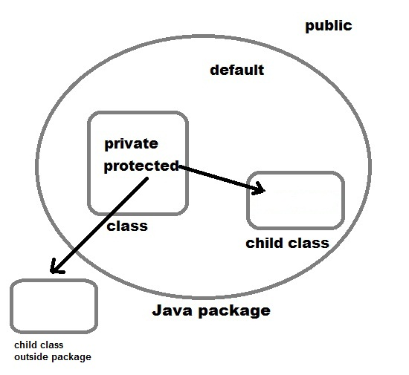

Slide 125
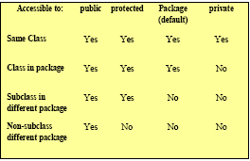
Visibility
Public keyword applied to a class, makes it available/visible everywhere. Applied to a method or variable, completely visible.
Private fields or methods for a class only visible within that class. Private members are not visible within subclasses, and are notinherited.
Protected members of a class are visible within the class, subclasses and also within all classes that are in the same package as that class.
Default access Also referred to as package access, A member with default access is accessible to any other classes in the same package

Slide 126
Access Specifiers
Notice that protected and default are similar because they grant access to other classes in the same package.
  Protected is actually less restricted than the default because protected also grants access to child classes that may be outside of the package.
A class can also have an access specifier. The only two access specifiers that can be used for a class are public and the default.
  Every class we have seen up until now has been declared. A public class can be used by any other class. A class with the default access can only be used by other classes in the same package.

Slide 127
Non-access Modifier
Non-access modifiers do not change the accessibility of variables and methods, but they do provide them special properties. Non-access modifiers are of 5 types,
Final
Static
Transient
Synchronized
Volatile

Slide 128
Final modifier is used to declare a field as final i.e. it prevents its content from being modified. Final field must be initialized when it is declared.
Example :
class Cloth { final int MAX_PRICE = 999; //final variable final int MIN_PRICE = 699; final void display() //final method { System.out.println("Maxprice is" + MAX_PRICE ); System.out.println("Minprice is" + MIN_PRICE); } }
A class can also be declared as final.
A class declared as final cannot be inherited. String class in java.lang package is a example of final class. Method declared as final can be inherited but you cannot override(redefine) it.

Slide 129
Static Modifier
Static Modifiers are used to create class variable and class methods which can be accessed without instance of a class. Lets study how it works with variables and member functions.
Static variable are used to represent common property of a class. It saves memory.
Suppose there are 100 employee in a company. All employee have its unique name and employee id but company name will be same all 100 employee.
Here company name is the common property. So if you create a class to store employee detail, company_name field will be mark as static.
class Employee { int e_id; String name; static String company_name = "StudyTonight"; }

Slide 130
Example
class ST_Employee
{
int eid; String name;
static String company_name ="StudyTonight";
public void show()
{ System.out.println(eid+" "+name+" "+company_name);
}
public static void main( String[] args )
{
ST_Employee se1 = new ST_Employee();
se1.eid = 104; se1.name = "Abhijit";
se1.show();
ST_Employee se2 = new ST_Employee();
se2.eid = 108;
se2.name = "ankit"; se2.show();
}
}
Output:104 Abhijit StudyTonight 108 ankit StudyTonight

Slide 131
Methods in Java
  Methods in Java can appear only within a class because Java is a strictly object-oriented programming language.
In many languages, methods appear at a global level and can be invoked at any time.
In Java, methods (not declared as static) can only be invoked on instances of the class.
  If you do want to write a global-type method that can be invoked by anyone at any time without requiring an instance of a class, you write a static method
A static method is essentially equivalent to the concept of a global method

Slide 132
Invoking Methods
A method is invoked, causing it to be placed at the top of the call stack until it is finished executing. When a method is done executing, three things can occur:
The method returns a value, in which case a primitive data type or reference is passed back to the caller of the method.
The method does not return a value, in which case the return value is declared as void.
The method throws an exception, which is thrown back to the caller of the method. Exceptions are discussed seperately, “Exception Handling.”
In all three of these cases, the flow of control jumps back to the caller of the method.
To demonstrate the flow of control of methods, let’s look at an example.

Slide 133
public class Date
{
public int day, month, year;
public int getDay()
{
System.out.println(“Inside getDay method”);
return day;
}
public void printDate()
{
System.out.println(“Inside printDate method”);
108 Chapter 5
System.out.println(month + “/” + day + “/” + year);
}
}
The given Date class is a simple class that could be used to represent a calendar
date.
How many fields does the Date class have?
How many methods?

Slide 134
In the given DateProgram, a Date object is instantiated and the two methods in the Date class are invoked. Study the DateProgram carefully and try to determine its output?
public class DateProgram
{
public static void main(String [] args)
{
System.out.println(“Within main...”);
Date today = new Date();
today.day = 23;
today.month = 07;
today.year = 2014;
System.out.println(“The day is “ + today.getDay());
System.out.println(“Printing the date...”);
today.printDate();
System.out.println(“What is displayed next?”);
today.getDay();
}
}

Slide 135
Static Methods
Methods in Java can appear only within a class because Java is a strictly object-oriented programming language.
In many languages, methods appear at a global level and can be invoked at any time.
In Java, methods (not declared as static) can only be invoked on instances of the class.
If you do want to write a global-type method that can be invoked by anyone at any time without requiring an instance of a class, you write a static method
A static method is essentially equivalent to the concept of a global method

Slide 136
Methods
Special types of Methods;
Constructors
Accessors
Mutators
Are they essential ?
What do they do ?

Slide 137
Constructors
A constructor is a special method in a class that is invoked when the object gets instantiated.
  The purpose of a constructor is to allow the fields of the object to be initialized when the object is instantiated.
If you write a class and do not add a constructor, the compiler generates a default constructor in your class.
This default constructor is public, has no parameters, and does not do anything.

Slide 138


